Slide 1
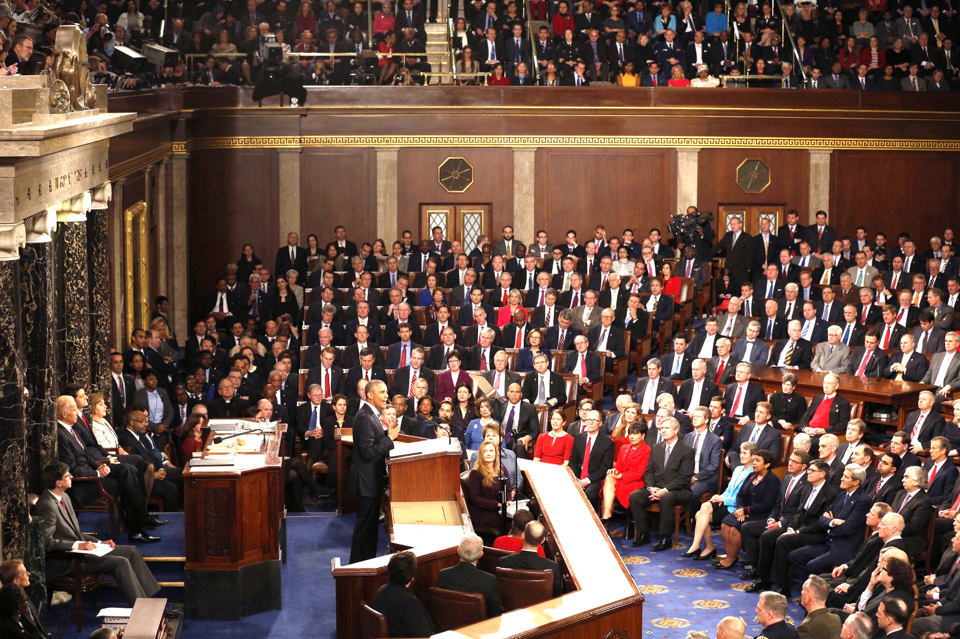
Javascript 2016
State of the union

Slide 2
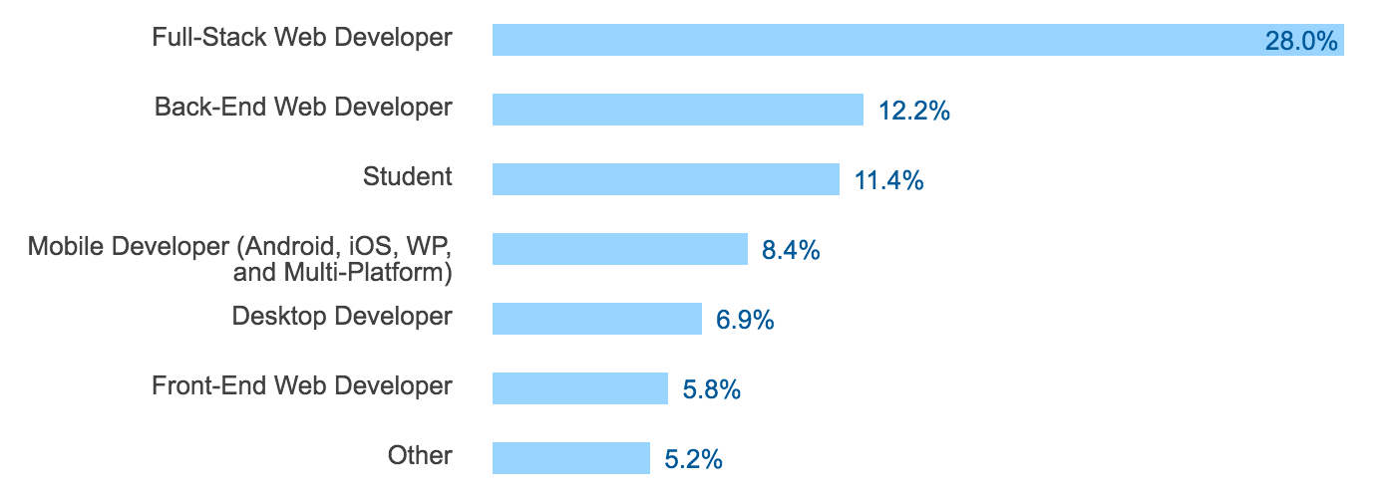
Developer occupations and Javascript
[0] - http://stackoverflow.com/research/developer-survey-2016

Slide 3
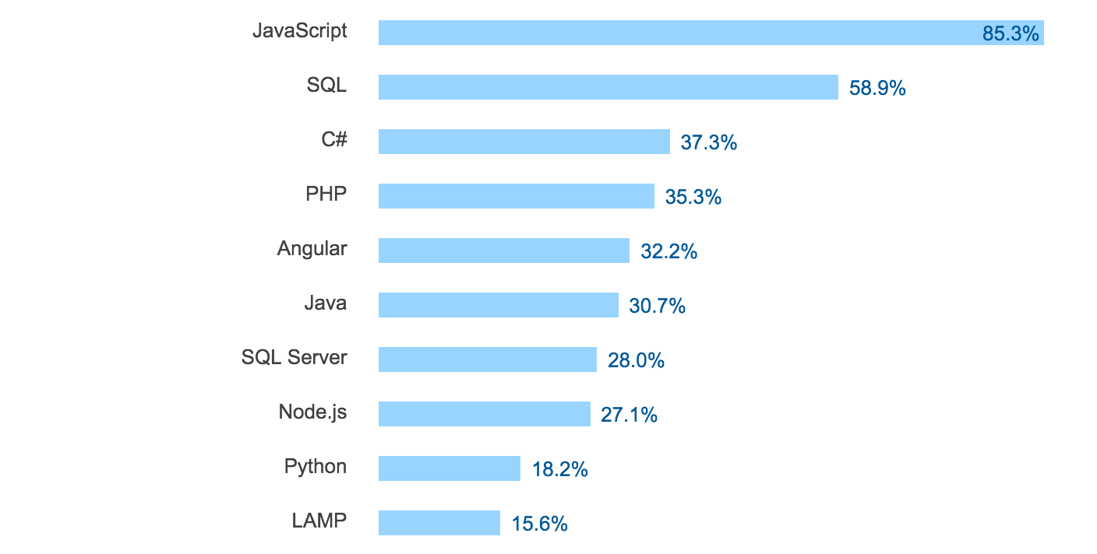
Most Popular Technologies per Dev Type - Full Stack
[0] - http://stackoverflow.com/research/developer-survey-2016

Slide 4
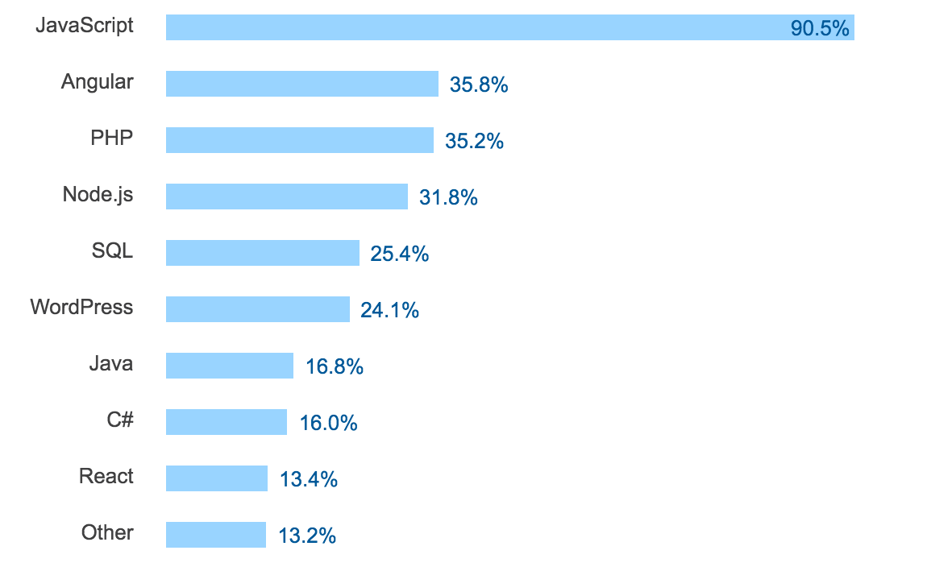
Most Popular Technologies per Dev Type - Front End
[0] - http://stackoverflow.com/research/developer-survey-2016

Slide 5
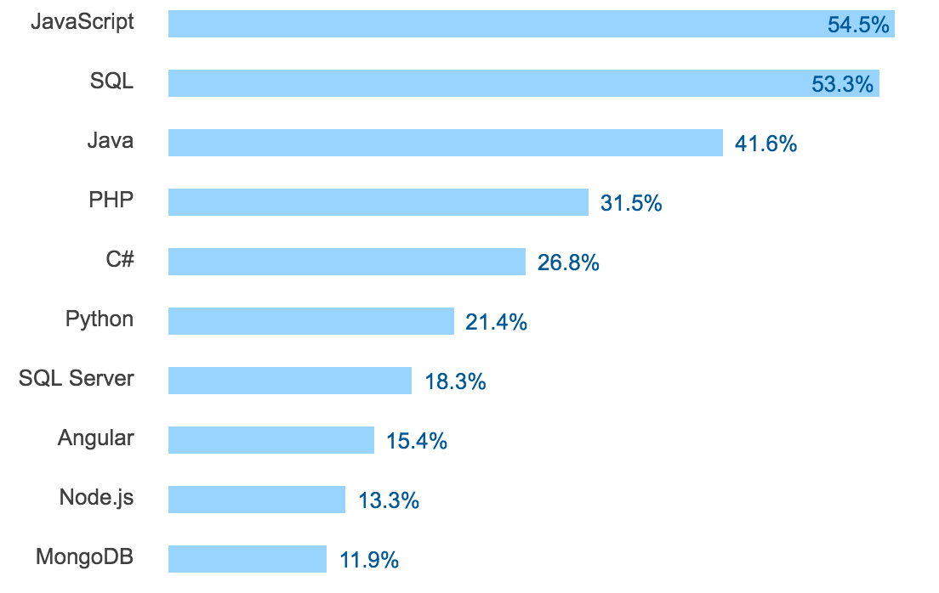
Most Popular Technologies per Dev Type - Backend
[0] - http://stackoverflow.com/research/developer-survey-2016

Slide 6
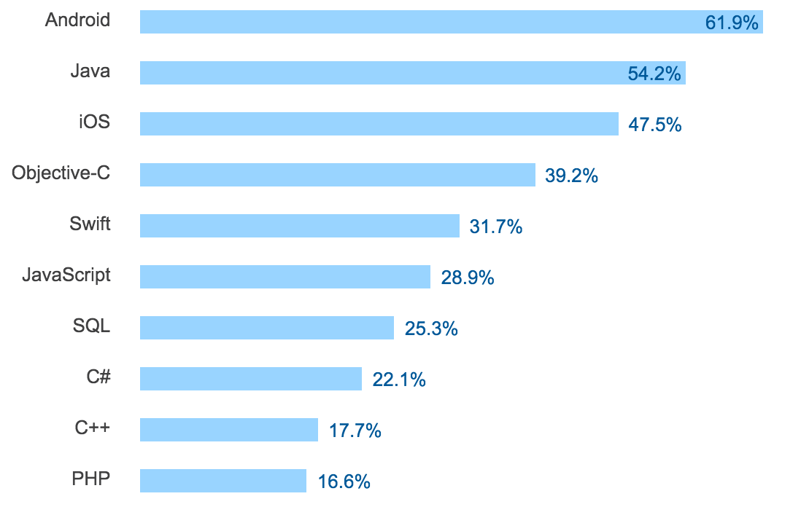
Most Popular Technologies per Dev Type - Mobile
[0] - http://stackoverflow.com/research/developer-survey-2016

Slide 7
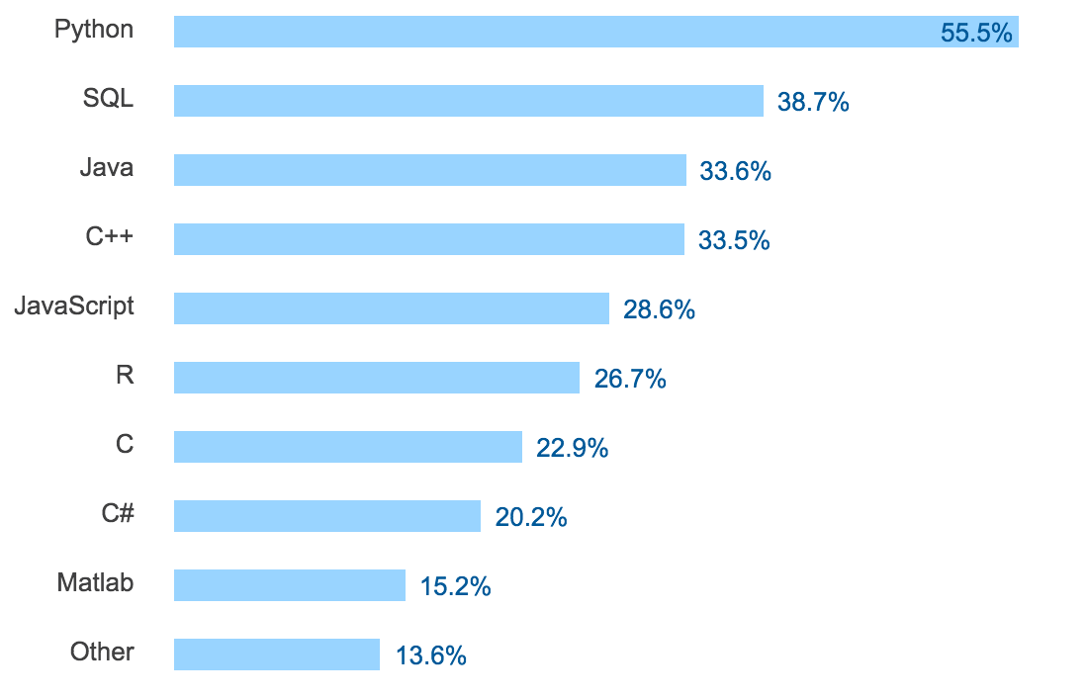
Most Popular Technologies per Dev Type - Science
[0] - http://stackoverflow.com/research/developer-survey-2016

Slide 8
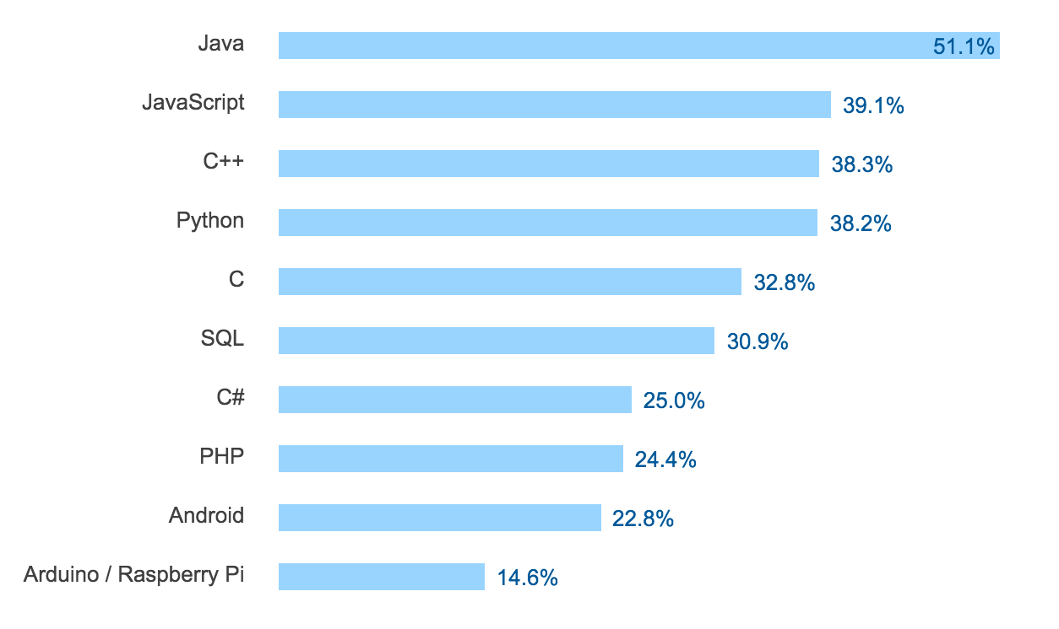
Most Popular Technologies per Dev Type - College
[0] - http://stackoverflow.com/research/developer-survey-2016

Slide 9
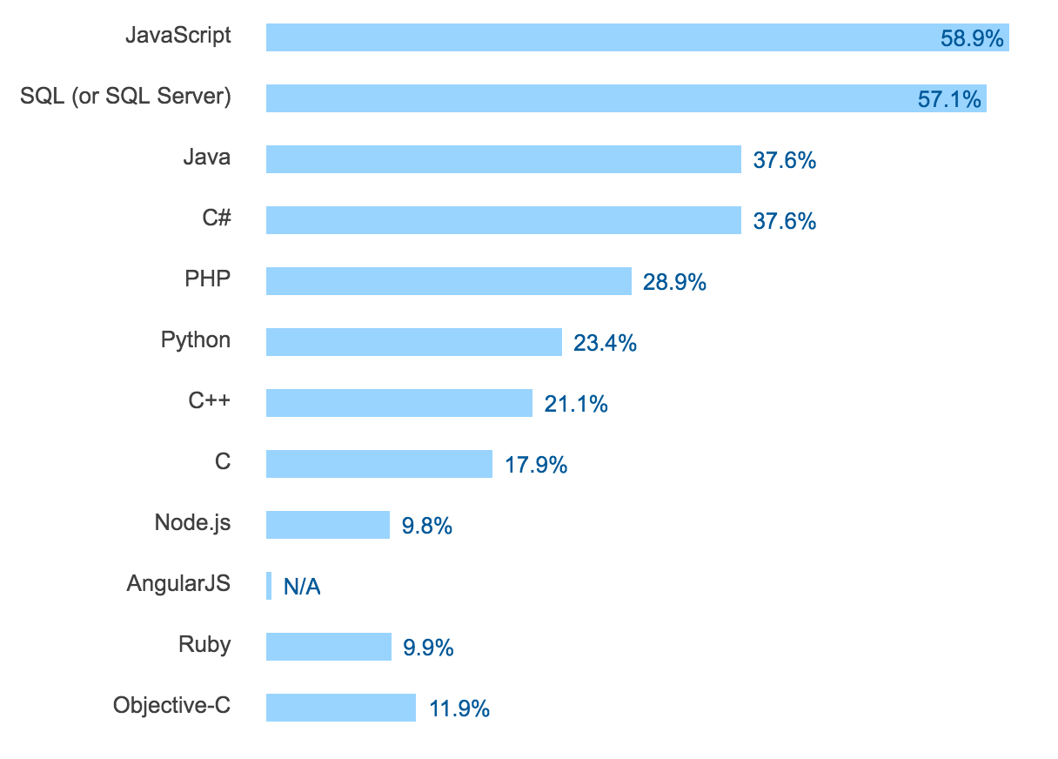
Most Popular Technologies - 2014
[0] - http://stackoverflow.com/research/developer-survey-2016

Slide 10
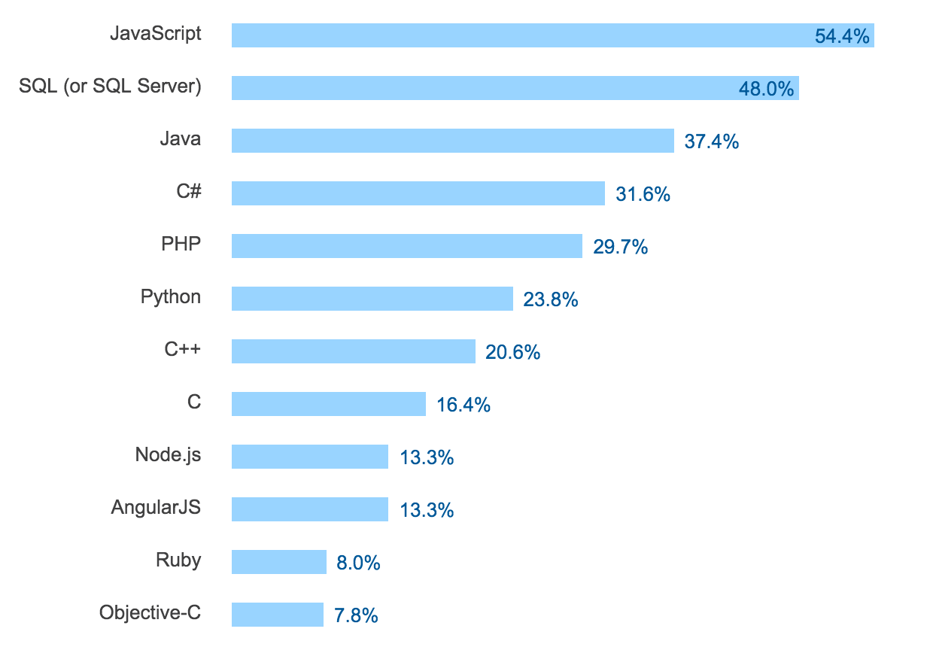
Most Popular Technologies - 2015
[0] - http://stackoverflow.com/research/developer-survey-2016

Slide 11
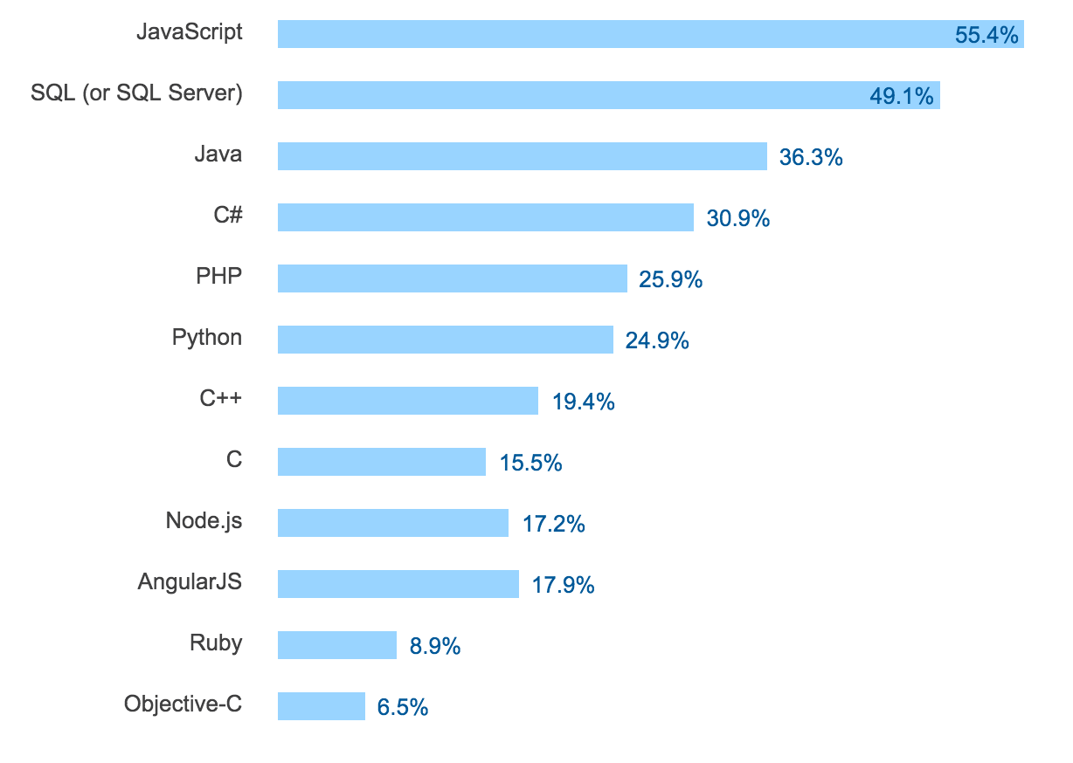
Most Popular Technologies - 2016
[0] - http://stackoverflow.com/research/developer-survey-2016

Slide 12







Javascript roadmap
ES7 features:
Array.prototype.includes
Exponentiation operator
Mas alla de ES7:
Async / wait
Operadores asincronicos
String padding

Slide 13






NodeJS roadmap
Node JS foundation
LTS y Stable
100% crecimiento interanual (3.5 millones de desarrolladores activos)
93% ES6 compliant

Slide 14
Scoping

